Slide 1
Working With Reverse Engineering Output for Benchmarking and Further Use
David Cutting and Joost Noppen
University of East Anglia
david.cutting@uea.ac.uk, j.noppen@uea.ac.uk

Slide 2
Presentation Outline
Problem Statement
Benchmarking of Reverse Engineering
Working Further with Reverse Engineering Output for Analysis and Comparison
Next Steps

Slide 3
The Problem
Software grows organically
Links with documentation easily lost through uncontrolled change
Pressure for further change still present
Very difficult to perform change impact analysis if we don’t know what components relate to one another

Slide 4
Reverse Engineering
One of the main sources of information about software is the software itself
Reverse engineering offers a powerful tool for program comprehension
There are a lot of reverse engineering tools but…

Slide 5
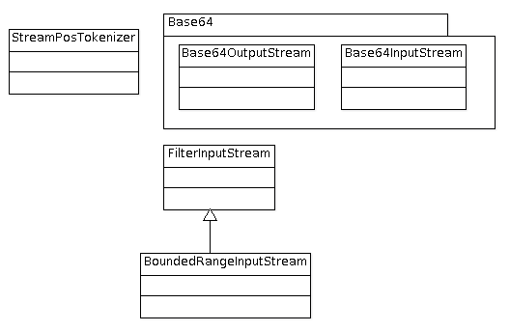
Reverse Engineering Tools
Although there are many tools they
Vary in output (which is right, which is wrong?)
Have no standard means of comparison
This is org.jhotdraw.io from Rational Rhapsody:

Slide 6
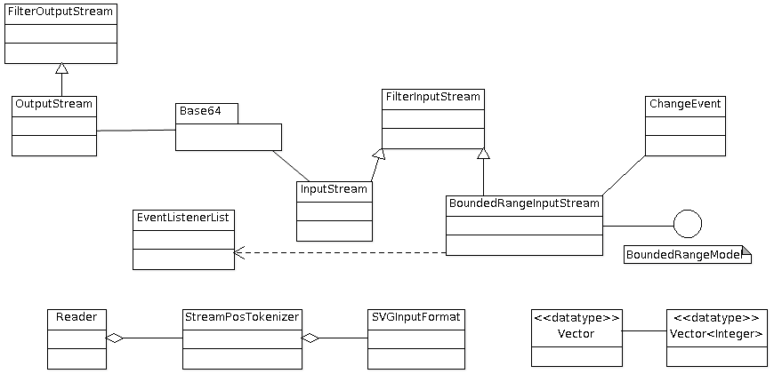
Reverse Engineering Tools
org.jhotdraw.io from Astah Professional:
org.jhotdraw.io from ArgoUML:

Slide 7
Reverse Engineering Tools
These are all 100% correct:

Slide 8
The Benchmark
To compare and rank different tools we created a benchmark (the Reverse Engineering to Design Benchmark: RED-BM)
16 target artifacts
Varying from 100 to 40,000 lines of code
From 7 to 450 classes
Range of architecture styles and complexity
“Gold standard” for each in terms of contained classes and sampled relationships

Slide 9
The Benchmark
Existing designs where available
Reverse engineering output from other tools for comparison
Initial measures for class detection, packages, and relationships:
For artifact x: Cl(x) is the ratio of correct classes, Sub(x) ratio of correct packages and Rel(x) ratio of correct relationships in system s for result r

Slide 10
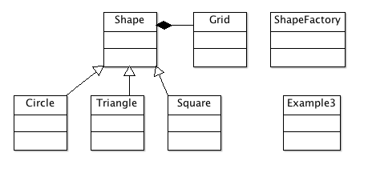
Benchmark Measures
Reference Diagram
Classes: 7
Relationships: 4
Sub-Classes: N/A

Slide 11
Benchmark Measures
Reference Diagram
Classes: 7
Relationships: 4
Sub-Classes: N/A

Slide 12
Benchmark Measures
Measure | Reference
Classes | 7
Relationships | 4

Slide 13
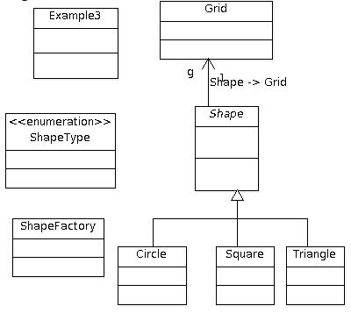
Benchmark Measures
Measure | Reference | ArgoUML
Classes | 7 | 7
Relationships | 4 | 4

Slide 14
Benchmark Measures
Measure | Reference | ArgoUML
Classes | 7 | 7
Relationships | 4 | 4

Slide 15
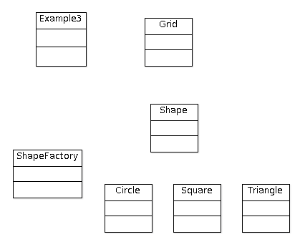
Benchmark Measures
Measure | Reference | ArgoUML | SIM
Classes | 7 | 7 | 7
Relationships | 4 | 4 | 0

Slide 16
Benchmark Measures
ArgoUML:
SIM:

Slide 17
Overall Performance
Individual measures fed into weighted Compound Measure (CM) as function P:
In this case, with equal weightings:

Slide 18
Extensibility
Extensibility – existing and new measures can be combined into new or redefined (refocused) compound measure C:
Design pattern detection, architectural styles or components (MVC etc)

Slide 19
Benchmark Analysis
We ran a 12 industry reverse engineering tools against the 16 target artifacts
We then compared output against our “Gold Standard”
Rather than doing this manually we used the XMI output from tools (more on this later)
What we found was quite surprising…

Slide 20
Benchmark Results

Slide 21
Key Findings
Wide variance in performance between tools (8.8% to 100%)
RED-BM is effective at differentiating tool performance
You don’t always get what you pay for!

Slide 22
Benchmark Results

Slide 23
Working Further With Reverse Engineering Output
Benchmarking shows clear differences but we want to be able to use output from reverse engineering for further use
Aggregation of output (bringing together multiple imperfect outputs)
Combination with other sources of information
Making better use of the information than we can with generated diagrams

Slide 24
The Problem with Diagrams

Slide 25
The Problem with Diagrams

Slide 26
XML Metadata Interchange (XMI)
XMI is an Object Management Group (OMG) Meta-Object Facility (MOF) for exchange of Unified Modeling Language (UML)
So XMI = OMG MOF UML (OMG is right!)
This is a standard but one offering extensibility on many levels
So effective interchange between tools is pretty much non-existent

Slide 27
Working with XMI
To create the benchmark we wanted to be able to analyse XMI rather than counting classes by hand
This entailed the creation of a generic XMI class finder
In turn this work led to a generic XMI parser to load XMI models into a standard format in memory

Slide 28
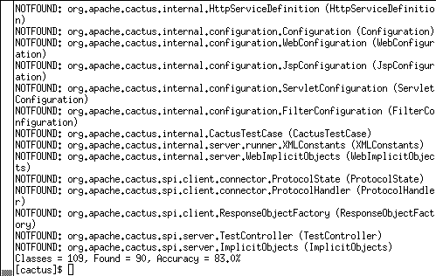
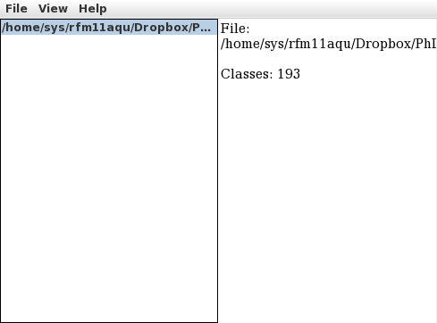
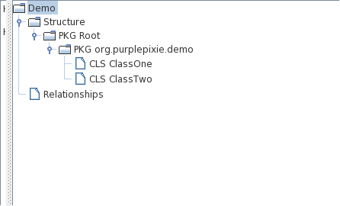
Working with XMI

Slide 29
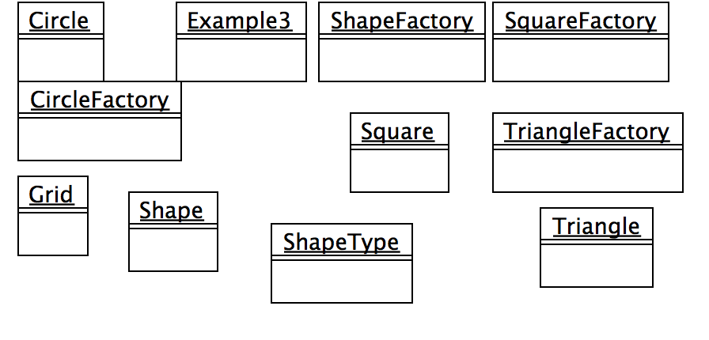
Reconstruction from XMI
Using UMLet within Eclipse

Slide 30
Combinational Relationships
In addition to other (cool) stuff we can do with reverse engineering output, we can build a relationship matrix
This is just a simple matrix showing all class pairings, and the count of relationships found between them

Slide 31
Combinational Relationships
 | A | B | C | D | E
A
B
C
D
E

Slide 32
Combinational Relationships
 | A | B | C | D | E
A
B
C
D
E

Slide 33
Combinational Relationships
 | A | B | C | D | E
A
B | A <> B
C
D
E

Slide 34
Combinational Relationships
 | A | B | C | D | E
A
B | A <> B
C | A <> C
D
E

Slide 35
Combinational Relationships
 | A | B | C | D | E
A
B | A <> B
C | A <> C | B <> C
D | A <> D | B <> D | C <> D
E | A <> E | B <> E | C <> E | D <> E

Slide 36
Relationship Matrix
Simple representation of shared relationships
Can be generated from multiple different sources and is lowest common denominator
Many other possible sources of information of this type…

Slide 37
Relationship Matrices…
Not limited to just object pairings – any pairings of components
Requirements and Classes
Documents and Requirements
…
As long as a compatible “view” can be easily used in combination with each other

Slide 38
Next Steps
Refine matrix modeler
Analysis of larger and real-world software
Improve XMI parser utility
More information sources
Documentation / Natural Language / Repositories
Stack traces / call stacks
How can we bring this together?
How we can set filters/thresholds sensibly?

Slide 39
Thank You
Any questions?
Feel free to email: david.cutting@uea.ac.uk

